Slide 1


SSH
Powerpoint 09. 05. 12

Slide 2
Using SSH keys
I recommend looking at this page:
http://blakesmith.me/2010/02/08/understanding-public-key-private-key-concepts.html
Also, this video explain it
https://www.youtube.com/watch?v=svRWcx7dT8g
There is a longer story on SSH on Lynda.com
https://www.lynda.com/Developer-Network-Administration-tutorials/Welcome/189066/365610-4.html

Slide 3
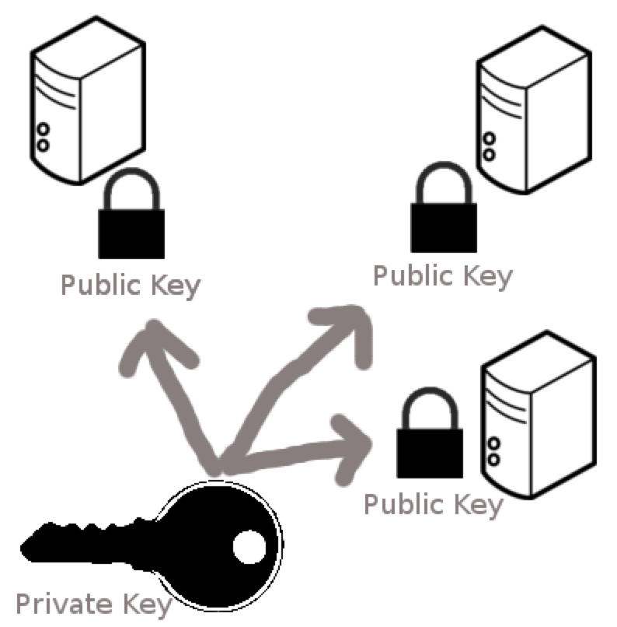

Public and private key
You store the private key on your computer
The public key is placed on the remote computer
You can place the public key on many computers

Slide 4
Encryption principle of SSH
A message encrypted using private can be decrypted by public key
A message encrypted using public can be decrypted using private key
Assume two parties A and B each has their private key, and the public key of the other.
How can A send a message to B which only B can read?
How can B be sure the message is from A?
(hard) – if B does not have A’s public key, how can B be sure a message is from A

Slide 5
ssh
Ressources:
https://www.digitalocean.com/community/tutorials/understanding-the-ssh-encryption-and-connection-process
https://en.wikipedia.org/wiki/Public-key_cryptography
Exercise for Wednesday:
Prepare a sequence diagram showing what communication takes place between the local machine and the machine on digital ocean when establishing a ssh connection.
The diagram can be on a slide, on paper – just something outside of your head ☺

